Slide 1

COMP20
Database Administration & Design

Slide 2
Normalization
Normalization is a formal process you can use to separate the data in a data structure into related tables. Normalization reduces data redundancy, which can cause storage and maintenance problems.
In an unnormalized data structure, a table can contain information about two or more entities. It can also contain repeating columns, columns that contain repeating values, and data that’s repeated in two or more rows.
In a normalized data structure, each table contains information about a single entity, and each piece of information is stored in exactly one place.
To normalize a data structure, you apply the normal forms in sequence. Although there are a total of seven normal forms, a data structure is typically considered normalized if the first three normal forms are applied.

Slide 3
First normal form 1NF
The first step, this is the basic requirement
If your table doesn’t comply to this form, it is considered poor DB design

Slide 4
First normal form 1NF
Rule 1: Each column must be a single value
Rule 2: A column should contain values of the same type
Rule 3: Each column should have a unique name
Rule 4: The order with which you store your data shouldn’t matter

Slide 5
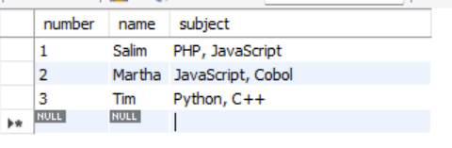
First normal form 1NF (fail)

Slide 6
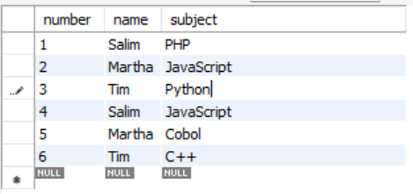
First normal form 1NF (pass)

Slide 7
Second normal form 2NF
Rule 1: Meets all 1NF rules
Rule 2: No partial dependencies in the table

Slide 8
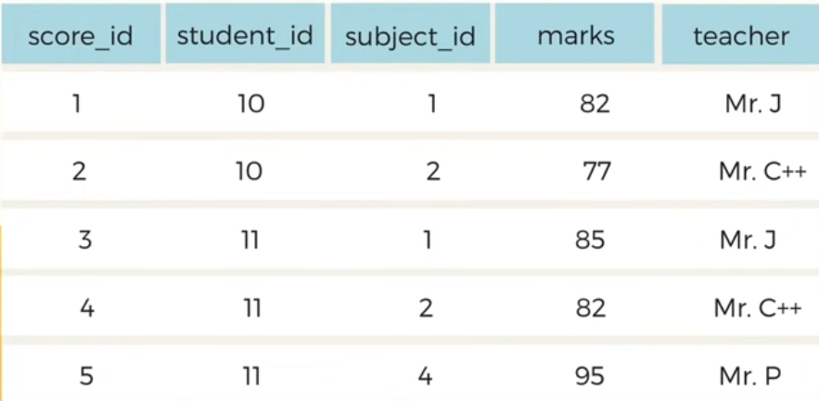
Second normal form 2NF (fail)

Slide 9
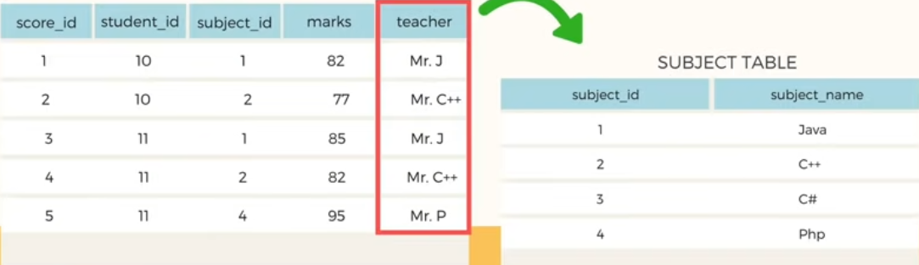
Second normal form 2NF (pass)

Slide 10
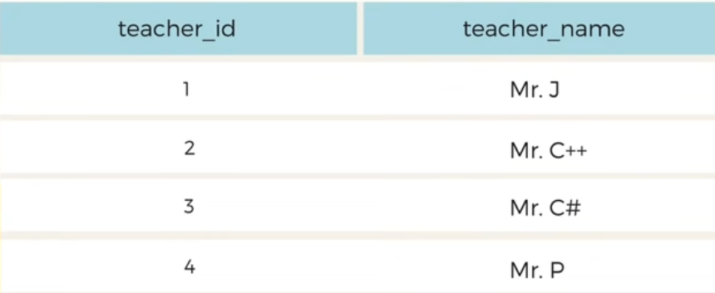
Second normal form 2NF (pass)

Slide 11
Third normal form 3NF
Rule 1: Meets 2NF rules
Rule 2: Every non-key column must depend only on the primary key

Slide 12

Third normal form 3NF (fail)

Slide 13
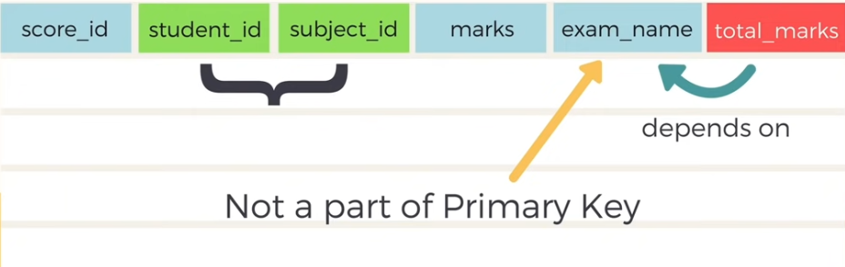
Third normal form 3NF (fail)

Slide 14
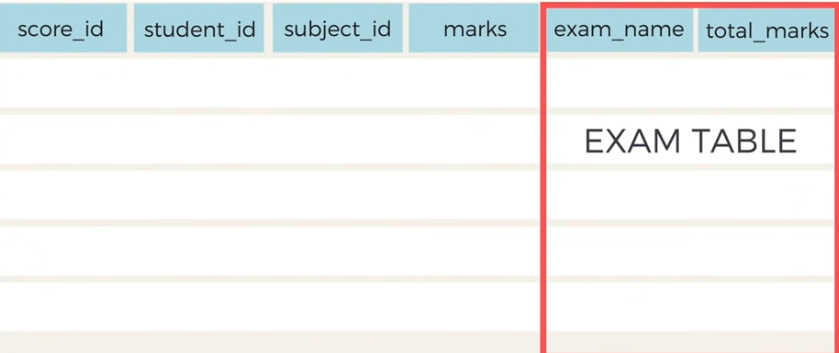
Third normal form 3NF (pass)

Slide 15
The benefits of normalization
Since a normalized database has more tables than an unnormalized database, and since each table has an index on its primary key, the database has more indexes. That makes data retrieval more efficient.
Since each table contains information about a single entity, each index has fewer columns (usually one) and fewer rows. That makes data retrieval and insert, update, and delete operations more efficient.
Each table has fewer indexes, which makes insert, update, and delete operations more efficient.
Data redundancy is minimized, which simplifies maintenance and reduces storage.

Slide 16
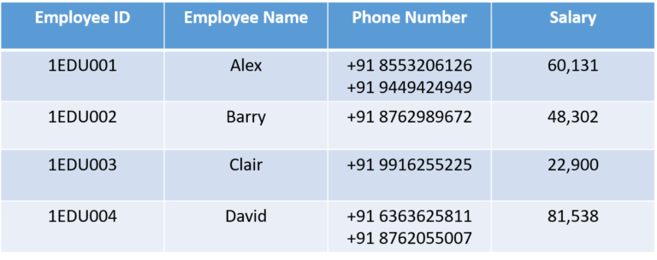
Un-normalized data set

Slide 17
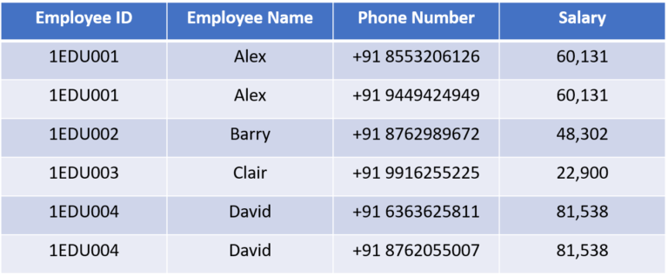
Applying 1NF

Slide 18
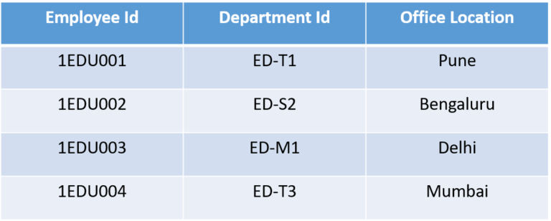
Un-normalized data set

Slide 19
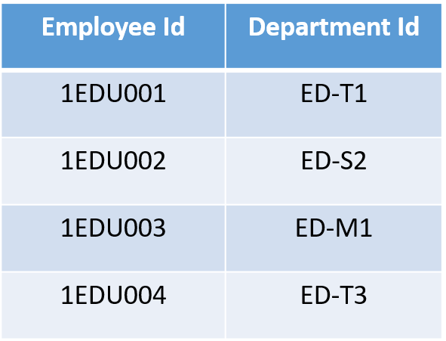
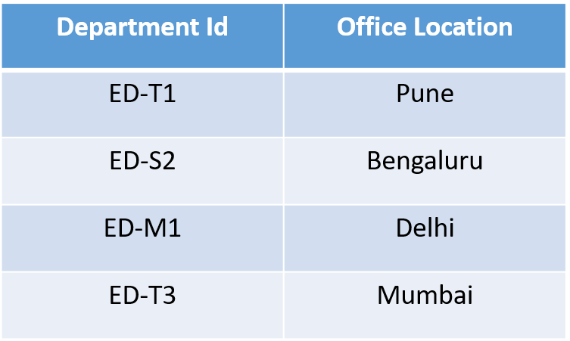
Applying 2NF

Slide 20
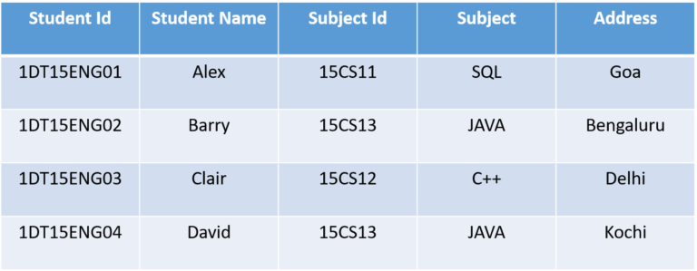
Un-normalized data set

Slide 21
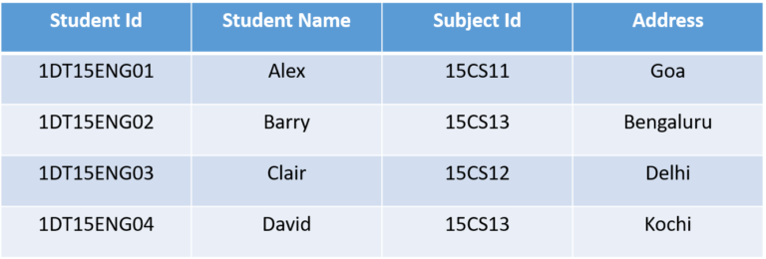
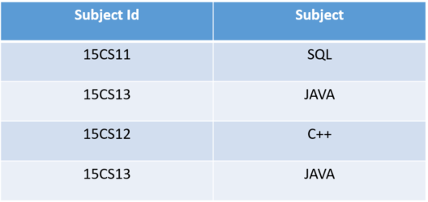
Applying 3NF

